Slide 1
Soil Aggregate Stability
Group: Toward Agroecology

Slide 2
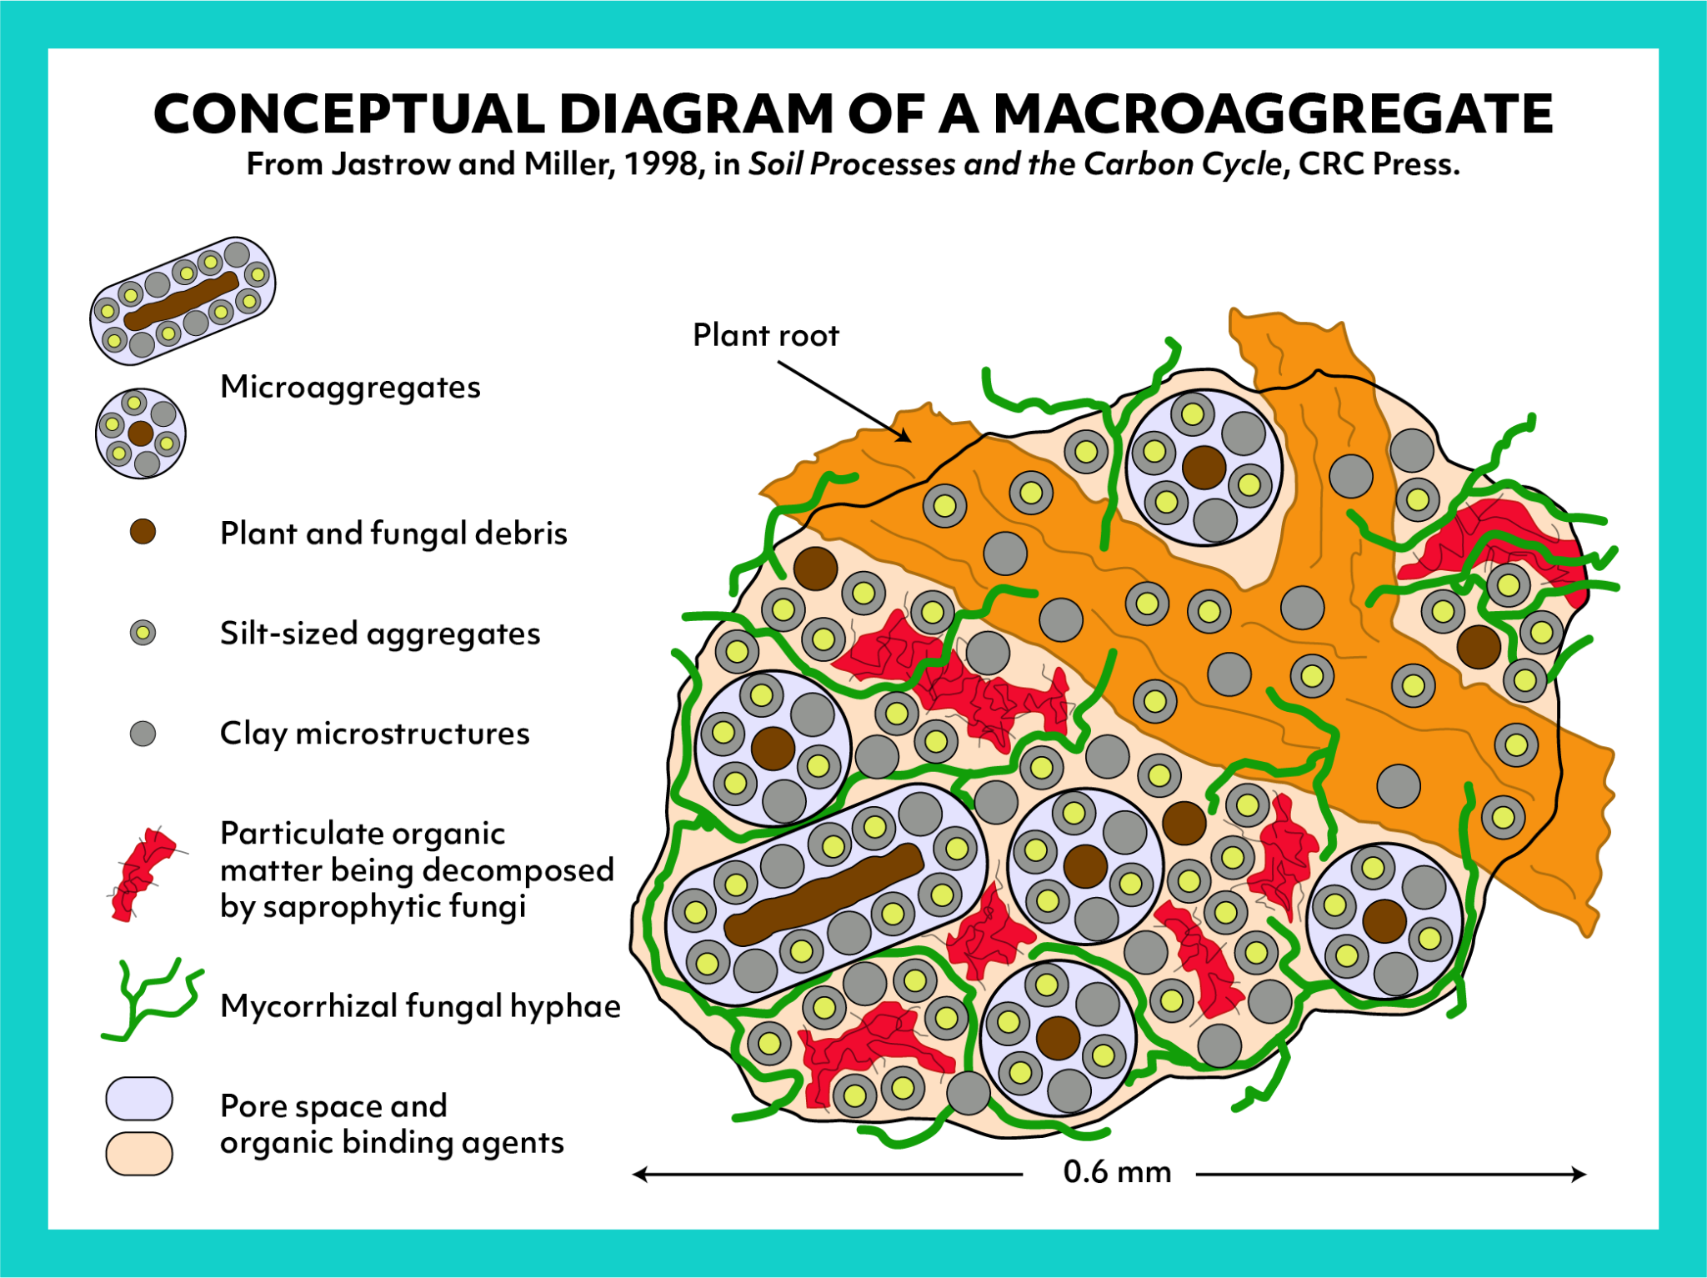
Soil Aggregate: The Rhizosphere for Plant Growth

Slide 3
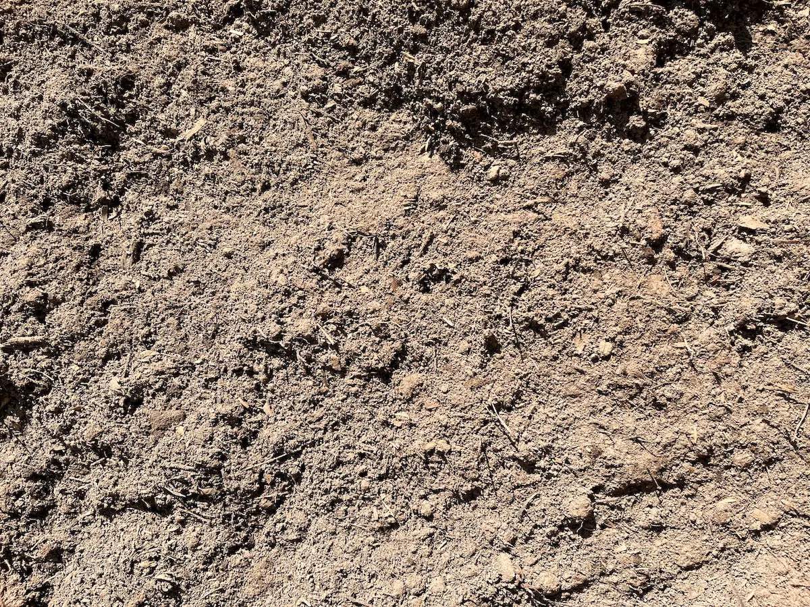
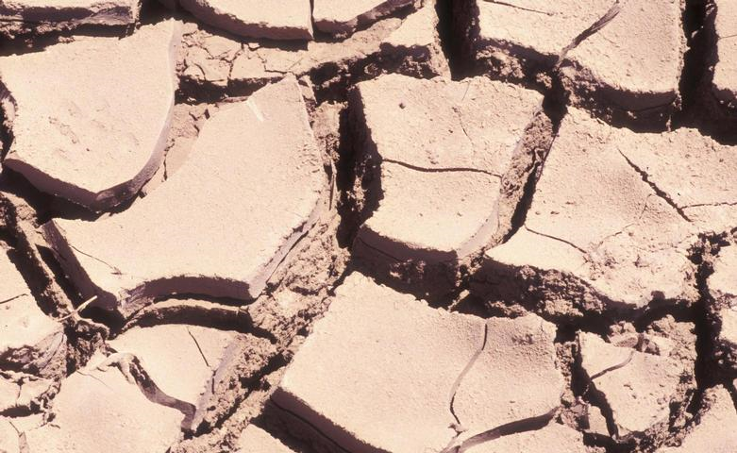
Which soil is health?

Slide 4
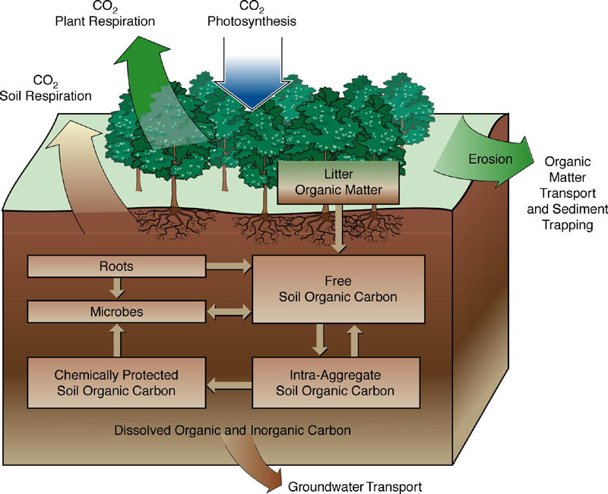
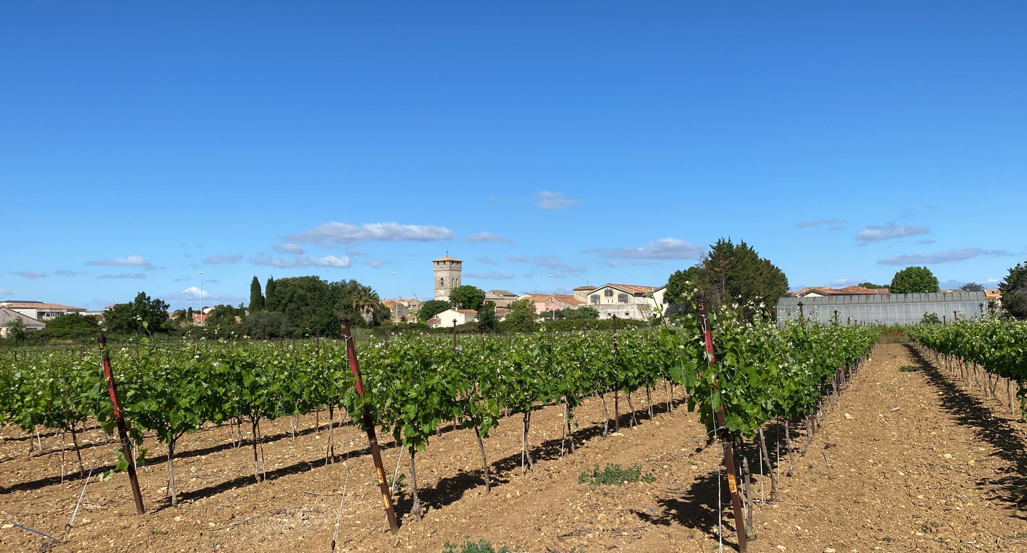
Soil Aggregate Instability Formation
Intensive/ continue cropping
Rapid decrease in the pool of organic carbon => stabilizing agent

Slide 5
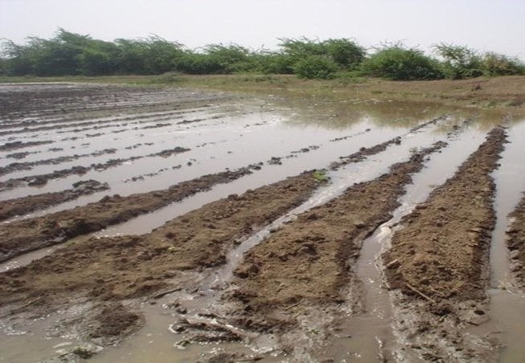
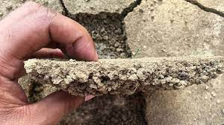
Surface crusting = aggregate breakdown under raindrop impact
Formation:
soil surface exposed to successive spells of rain
formation of a seal
forms a crust upon drying
Aggregate breakdown produces microaggregates

Slide 6
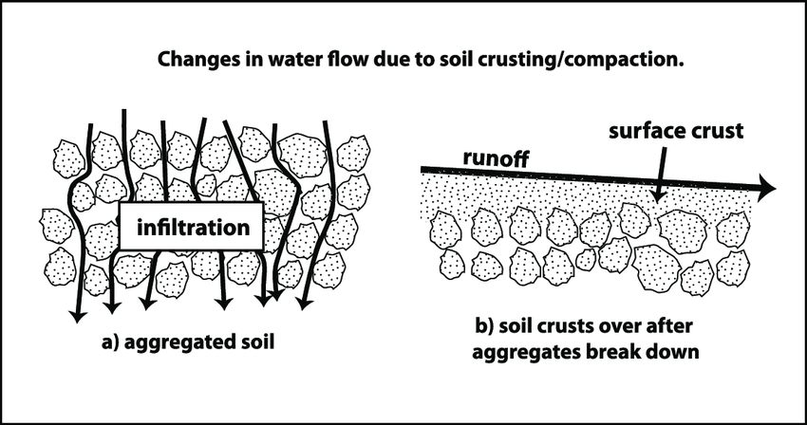
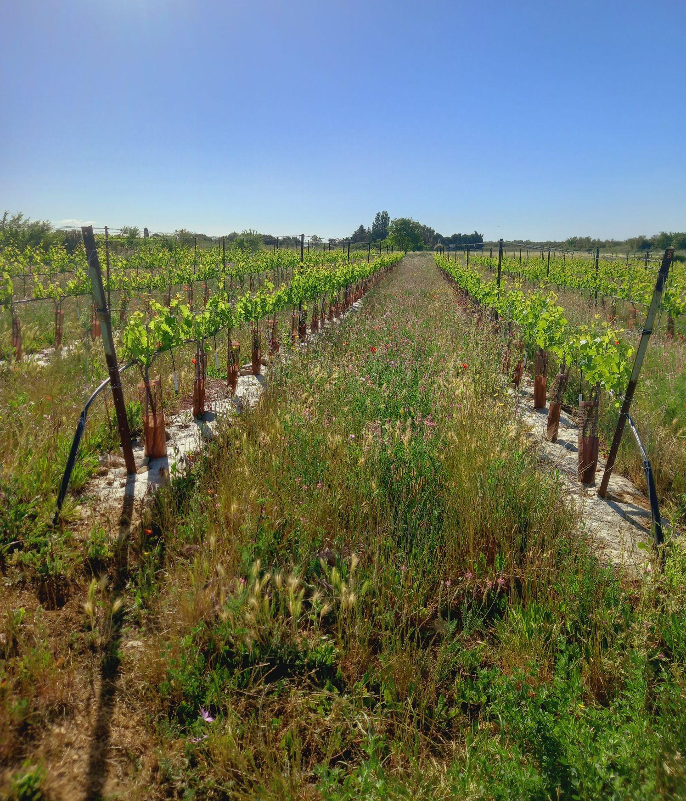
Consequences:
Solutions:
Vegetation cover or mulch which protect the soil surface
Reduces the infiltration rate
Induce erosion by increasing runoff
Soil degradation

Slide 7
Reference:
Le Bissonnais, Y. (2016). Aggregate stability and assessment of soil crustability and erodibility: I. Theory and methodology: Aggregate stability and assessment of soil crustability and erodibility. European Journal of Soil Science, 67(1), 11–21. https://doi.org/10.1111/ejss.4_12311
Le Bissonnais, Y., & Arrouays, D. (1997). Aggregate stability and assessment of soil crustability and erodibility: II. Application to humic loamy soils with various organic carbon contents. European Journal of Soil Science, 48(1), 39–48. https://doi.org/10.1111/j.1365-2389.1997.tb00183.x

